Slide 1
PROJECT TITLE : Analytics of Scanned Prescriptions and Notes.
PIP104 University Project-II
Review-0
Batch Number: G25
Roll Number | Student Name
20201CSE0095 | G RISHIKESH
20201CSE0120 | MANGAMURI RAMU
20201CSE0158 | TEJASWINI C
20201CSE0166 | SAMSON S
Under the Supervision of,
Mr. Ramesh T
Assistant Professor
School of Computer Science & Engineering
Presidency University

Slide 2
Introduction
A medical prescription given by a doctor contains the names of the medications, dosages and instructions for use for a specific patient.
It is generally handwritten by the busy doctor in an illegible way; which may be difficult for patients or sometimes even pharmacists to interpret the name of one or more medication(s) written in it.
Sometimes, the doctor may even write abbreviations for the directions of use of the medicines; which are commonly known to pharmacists nearby that hospital. The major criteria lies in identifying the name of the medicine correctly.
Hence, we are in need of a solution which uses CNN, NLP, OCR and machine learning techniques for handwriting recognition to identify the names of the medications in the prescription; given an image of the prescription.

Slide 3
Literature Review
As surveyed from the available literature on the project domain, like research papers, E-books, E-magazines, etc., the problem statement (i.e., extracting useful information from a scanned pdf document containing patient information) belonged to many domains such as :
Optical Character Recognition(OCR)
object recognition
text analytics
information retrieval(IR)
text mining
Comparison and classification
Machine Learning, etc.

Slide 4
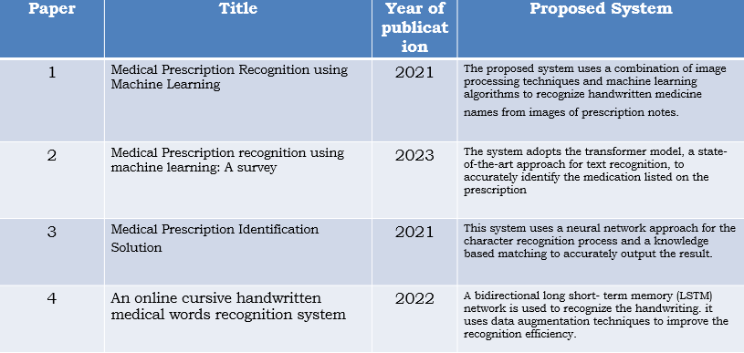
Literature Review

Slide 5
Proposed Method
To develop a mobile application which can take a cropped part of a medical prescription, containing only the doctor’s handwritten part as input; and recognize the names of the medications and it’s dosage accurately and return their names in a digital, readable form.
In order to achieve this, we implement a machine learning model using python and train it on various data sources, including EMINIST and Kaggle datasets.
In order to ensure seamless integration, we utilize TensorFlow, Keras and OpenCV for the backend of the application and cloud firebase for storing and managing the data. Once a user logs into the app, they have the option to scan or upload an image of their prescription. The app will then process the image using the machine learning model and display the recognized medication and its associated information for the user to easily read and understand.

Slide 6
Objectives
To assess the feasibility of using scanned prescription and notes for analysis.
To investigate the potential of Optical Character Recognition (OCR) and Natural Language Processing (NLP) techniques in analyzing the patterns (characters) of the cursive handwriting and recognize the medication.
designing a medication name recognizer for pharmacists or patients to enhance prescription-reading accuracy and patient safety.

Slide 7
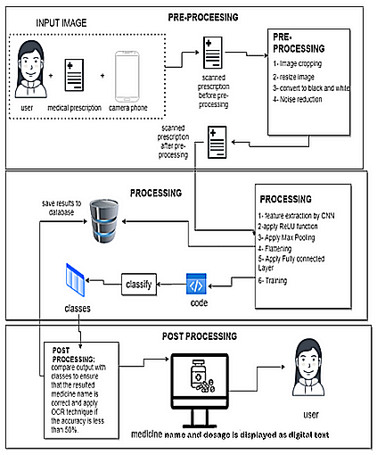
Methodology
The app is going to take a cropped image of the medical prescription containing only the doctor’s handwritten part ; and is going to identify the medicine names written in it and return the names in a readable, digital form.
It consists of 3 phases of processing : pre-processing, processing and post-processing.

Slide 8
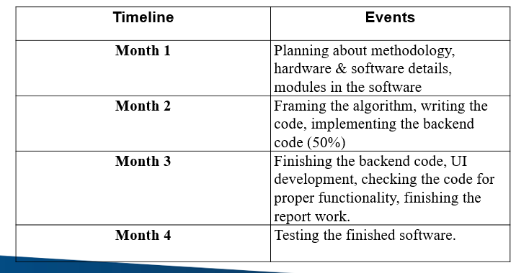
Timeline of Project
This project is expected to take 4 months(tentatively) for completion.

Slide 9
Expected Outcomes
The app to be built is expected to be useful for hospital
in-charges, pharmacists, patients or anyone who cannot interpret a doctor’s handwritten prescription containing medication names and it’s dosages.
As part of future work; this study may further focus on techniques to improve model accuracy; and an extended feature of translating medicine names written in the prescription to other language(without changing the name) and displaying them in the translated language. (if possible)

Slide 10
References
Medical Prescription Recognition using Machine Learning; by Esraa Hassan, Habiba Tarek, Mai Hazem, Shaza Bahnacy, Lobna Shaheen, Walaa H. Elashmwai
Medical Prescription Identification Solution, by W.R.A.D Wijewardena under the supervision of Prof. N.D. Kodikara
Medical prescription recognition using Machine Learning – A survey; by Neha Nayak, Prarthana T, Rohit Joshi, Vaibhavi S, Dr Swathi K
OCR Optical Character Recognition by Line Eikvil
Machine Printed Text and Handwriting Identification in Noisy Document Images; by Yefeng Zheng, Student Member, IEEE, Huiping Li and David Doermann, Members of IEEE.
An online cursive handwritten medical words recognition system for busy doctors in developing countries for ensuring efficient healthcare service delivery; by ShairaTabassum, Nuren Abedin, Md Mahmudur Rahman, Md Moshiur Rahman, Mostafa TaufqAhmed, Rafqul Islam & Ashir Ahmed
Identification of Handwritten Text in Machine Printed Document Images; by Sandipan Banerjee
Looking Beyond Text: Extracting Figures, Tables and Captions from Computer Science Papers Christopher Clark and Santosh Divvala
Automatic Indexing of Scanned Documents - a Layout-based Approach; by Daniel Essera, Daniel Schustera, Klemens Muthmanna, Michael Bergerb, Alexander Schilla aTU Dresden, Computer Networks Group, 01062 Dresden, Germany bDocuWare AG, Therese-Giehse-Platz 2, 82110 Germering, Germany

Slide 11
Thank You

